Slide 1
OCCUPATIONAL HEALTH HAZARDS Unit - 5

Slide 2
CONTENT
Introduction
Types
Consequences due to differents types of hazards

Slide 3
OCCUPATIONAL HEALTH HAZARDS
Occupational Health Hazards or called as occupational diseases
They are those diseases caused by the exposure to specific hazards at the workplace.
Characterstitics:-
Occurs mainly among working places
Exposure to workplace is essential
Notifiable and compensable

Slide 4
Occupational Hazards
Depending upon the occupation an industrial worker may be exposed to five types of hazards:-
Physical Hazards
Chemical Hazards
Biological Hazards
Mechanical Hazards
Psychosocial Hazards

Slide 5
Physical Hazards
Heat and cold Light
Noise Vibration
Ultraviolet radiation Ionizing radiation

Slide 6
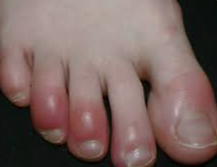
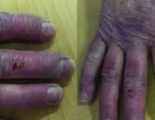
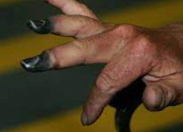
A) HEAT AND COLD
DISEASES DUE TO PHYSICAL AGENTS
HEAT
COLD
Direct effects:-
Burns
Heat exhaustion
Heat stroke and
Heat cramps
Indirect effects are:-
Decreased efficiency
Increased fatigue
Enhanced accidents rates
Effects associated with cold works are:-
Chilblains (swelling)
Erythrocyanosis (discoloration of skin)
Frostbite
General hypothermia

Slide 7


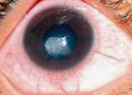
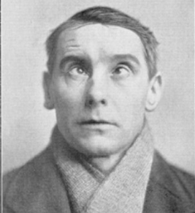
B) LIGHT
POOR ILLUMINATION
Acute effects:-
Eye strain
Headache
Eye pain
Lacrimation
Congestion around cornea
Eye fatigue
Chronic effects:-
Miner’s nystagmus (It is characterised by rapid involuntary movements of the eyes, associated with defect of vision
EXCESSIVE BRIGHTNESS
Effects due to glare :-
Discomfort, annoyance and
visual fatigue
Blurring of vision

Slide 8
C) NOISE
Auditory effects
Non-auditory effects
It includes:-
Temporary hearing loss
Permanent hearing loss
It includes:-
Nervousness
Fatigue
Interference in communication by speech
Decreased efficiency and annoyance
The degree of injury from the exposure to the noise depends upon a number of factors such as intensity and frequency range, duration of exposure and individual susceptibility.

Slide 9
D) VIBRATION
It is encounter in work with drills and hammers
Continuous work with such machines affects hands and arms.
The blood vessels of fingers may become increasingly sensitive to spasm.
It may also produce injuries of the joints of the hands, elbow shoulder.

Slide 10
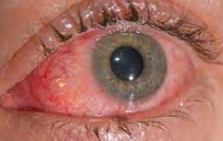
E) ULTRAVIOLET RADIATION
Mainly occurs in arc and other electric welding process
Effects due to ultraviolet radiation are:-
It mainly effects the eye causing:-
Intense conjunctivitis
Keratitis Keratitis is the inflammation of the cornea )

Slide 11
F) IONIZING RADIATION
Effects due to ionizing radiation are:-
Cancer
Leukemia
Ulceration
Genetic changes
Chromosomal mutation eg. sterility
Malformation
And ultimately death

Slide 12
A) Disease due to Physical agents
Heat | Prickly heat, syncope, heat hyperpyrexia, heat exhaustion
Cold | Hypo-thermia, frostbite, Treench foots
Light | Occupational cataract
Noise | Deafness
Radiation | Cancer, Leukaemia
Vibration | Sensitive to spasm

Slide 13
Chemical hazards
Local action Inhalation
Dusts
Gases
Metal and their compounds

Slide 14
LOCAL ACTION
Chemicals cause irritation, allergic reaction, dermatitis, eczema, ulcers and even cancer.
Chemicals causing occupational skin disease:-
Machine oil
Caustic
Lime
Some chemical like aromatic nitro and amino compounds absorb through skin and cause systematic effects
Eg alinine

Slide 15
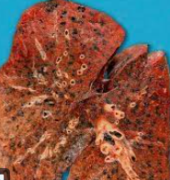
Disease due the chemical Agents
Diseases due to chemical agents Diseases
1) Gases (co₂ , co, NH₃, N_{2,} H₂S, SO₂ Gas poisioning
,etc)
-
Dusts (Pneumoconiosis)
Inorganic dusts:-
Coal dusts
Silica
Asbestos
Iron
Anthracosis Silicosis
Asbestosis, Lungs cancer Siderosis
Anthracosis of a lung
II. Organic dusts:-
Cane fiber
Cotton duct
Tobacco
a. Hay or grain dust
Bagassosis Byssinosis Tobacossis Farmer’s lung

Slide 16
Metals and their compounds (due to inhalation) | Toxic hazards from lead, mercury, cadmium, arsenic, etc.
Disease due to biological agents | Anthrax, Tuberculosis, encephalitis Leismaniasis, Hepatitis, fungal infections etc
Occupational cancer | Cancer of skin, lungs, Bladder.
Occupational dermatitis | Dermatitis, Eczema

Slide 17
Biological Hazards
Workers exposed to infective and parasitic agents at the place of work.
Mainly prevalent in developing countries resulting in higher risk for the workers.

Slide 18
People exposed to the occupation like:-
In health care setting workers are in high risk of Hepatitis, Tuberculosis, HIV, encephalitis, etc.
Agricultural workers , people working on animal husbandry animal products are in risk of zoonotic disease, worm infestation, tetanus, etc.

Slide 19
Mechanical Hazards
May cause due to protruding moving parts of machinery.
Sometimes due to own carelessness

Slide 20
Psychosocial Hazards
Rise when worker fails to adopt to an alien psychosocial environment which leads to psychological factors such as:-
Frustration
Lack of job satisfaction
Poor human relationship
Emotional tensions etc

Slide 21
The health effects cause due to psychosocial hazards are:-
Psychological and behavioural change
Psychosomatic ill health

Slide 22
Psychological and behavioural change
It includes:-
Hostility/ unfriendly
Anxiety
Depression
Tiredness
Aggressiveness
Drug abuse
Absenteeism

Slide 23
Psychosomatic ill health
It includes:-
Fatigue
Pain in shoulder, neck and back
Prone to peptic ulcer
Hypertension
Heart disease
Rapid aging

Slide 24

Guess the hazards?

Slide 25
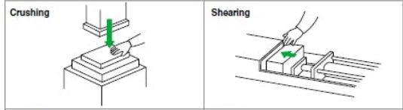
?

Slide 26

?

